Slide 1


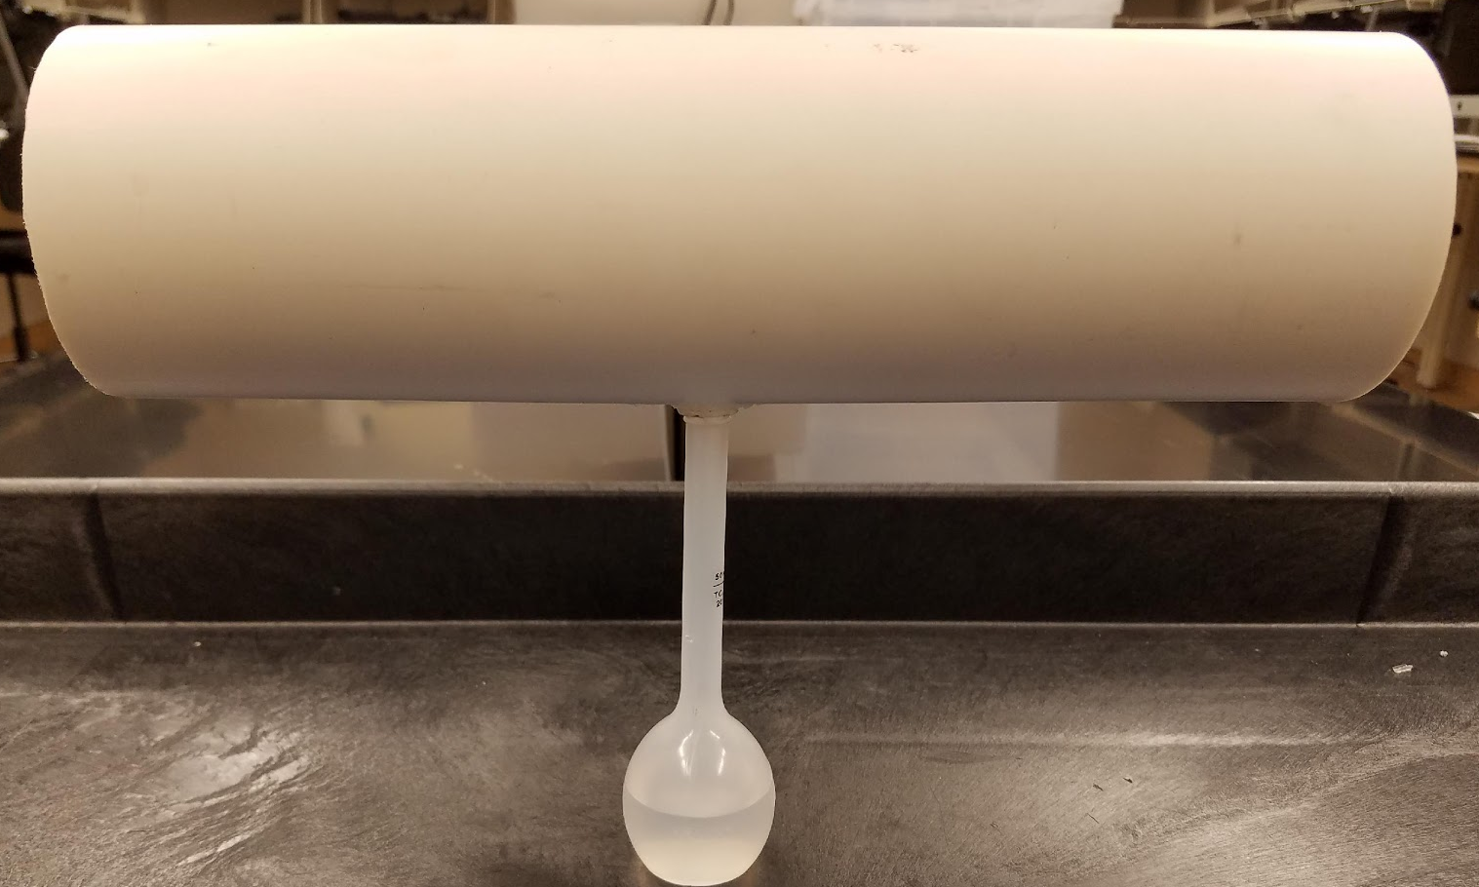
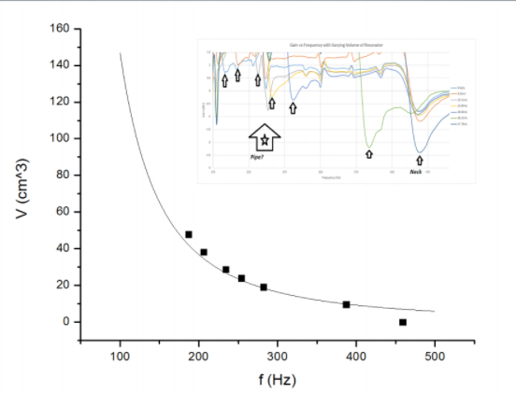
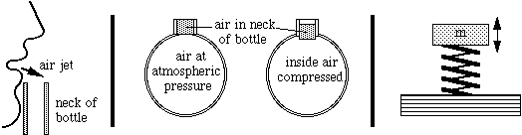
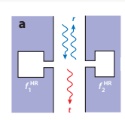
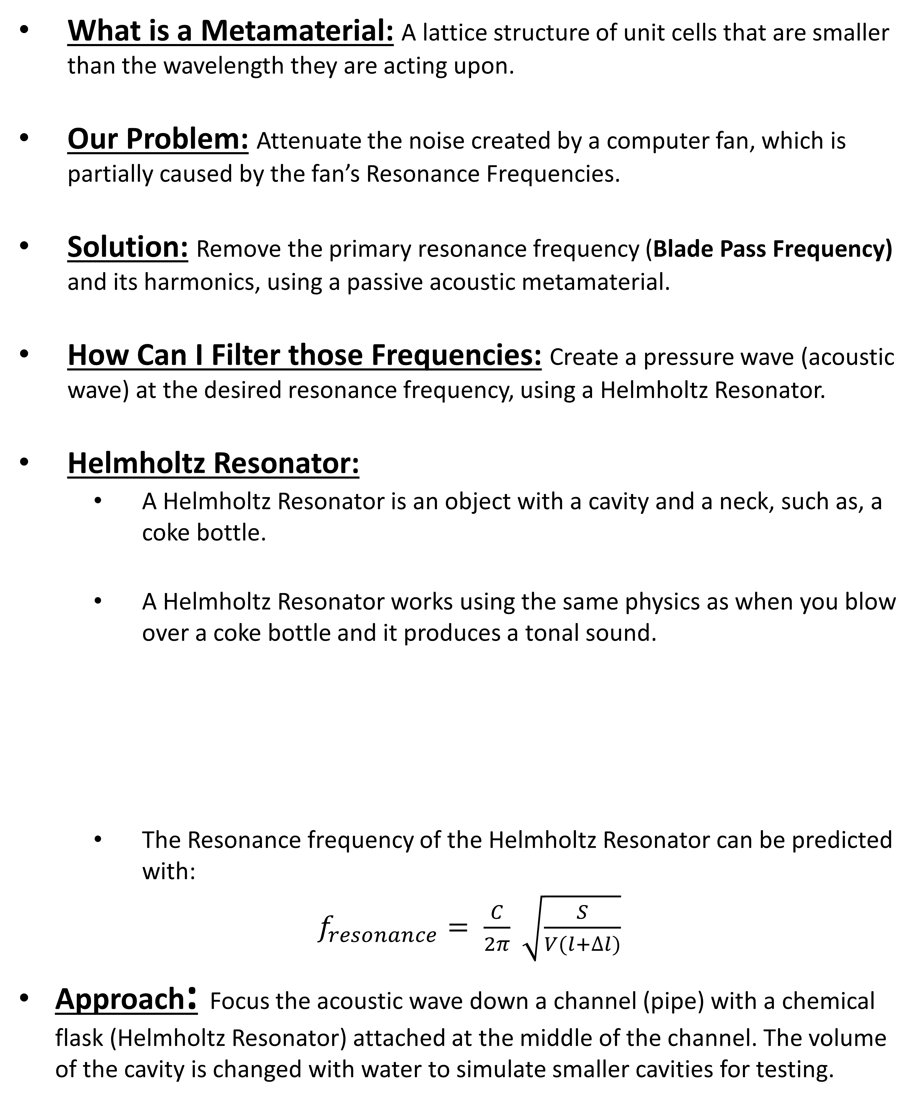
Design of an Acoustic Filter using Metamaterials
Professor: Dr. Ed Stokes, ECE Department, ebstokes@uncc.edu
ECE Graduate Student: Ryan Hill, rhill55@uncc.edu
What is a Metamaterial: A lattice structure of unit cells that are smaller than the wavelength they are acting upon.
Our Problem: Attenuate the noise created by a computer fan, which is partially caused by the fan’s Resonance Frequencies.
Solution: Remove the primary resonance frequency (Blade Pass Frequency) and its harmonics, using a passive acoustic metamaterial.
How Can I Filter those Frequencies: Create a pressure wave (acoustic wave) at the desired resonance frequency, using a Helmholtz Resonator.
Helmholtz Resonator:
A Helmholtz Resonator is an object with a cavity and a neck, such as, a coke bottle.
A Helmholtz Resonator works using the same physics as when you blow over a coke bottle and it produces a tonal sound.
The Resonance frequency of the Helmholtz Resonator can be predicted with:
$f_{resonance}= \frac{C}{2π} \sqrt{\frac{S}{V(l+∆l)}}$
Approach: Focus the acoustic wave down a channel (pipe) with a chemical flask (Helmholtz Resonator) attached at the middle of the channel. The volume of the cavity is changed with water to simulate smaller cavities for testing.
The Physical Model: The physical model that is used for testing is shown below.
Results: The theoretical frequency curve (solid black line) is approximately the same as the curve created by the measured data (block dots), for seven different cavity volumes.
Future Goals:
Use Yang and Sheng’s coupled acoustic resonator approach to reduce the cavity’s size without decreasing operation range, as shown below.

